Slide 1
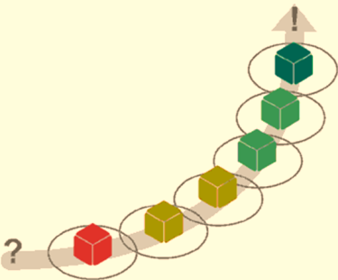
Fundamental Test Process
Main Phases And Principles
Software Quality Assurance
Telerik Software Academy
http://academy.telerik.com

Slide 2


The Lectors
Snejina Lazarova
Project Manager
BI & Reporting Team
Dimo Mitev
QA Architect
Backend Services Team

Slide 3

Table of Contents
Fundamental Test Process
Test Planning and Control
Test Analysis and Design
Test Implementation and Execution
Evaluating Exit Criteria and Reporting
Test Closure Activities
Metrics and Measurement
The Psychology Of Testing
Notes:
http://www.astqb.org/educational-resources/advanced-testing2.php
http://www.testingexcellence.com/fundamental-test-process/
http://en.wikipedia.org/wiki/IEEE_829
ISTQB - Foundation Level Syllabus 2010
Book: Software Testing Foundations - A Study Guide for the ISTQB Certified Tester Exam [2007]
Book: Advanced Software Testing - Vol. 1 - Guide to the ISTQB Advanced Certification as an Advanced Test Analyst [2008]
An example of a Test Plan is provided in "Practical software testing", Ilene Burnstein

Slide 4
Fundamental Test Process
Begin
Test Planning and Control
Test Analysis and Design
Test Implementation and Execution
Evaluating Exit Criteria and Reporting
Test Closure Activities
End

Slide 5

Test Planning And Control
Defining The Main Test Strategy

Slide 6

Test Planning And Control
Starts at the beginning of the software development project
Must be regularly checked, updated, and adjusted

Slide 7
Planning of The Resources
Necessary resources:
Which employees are needed, for what, when?
How much time is needed?
Which tools, equipment and utilities?
Necessary training of the employees
Organizational structure
With the appropriate test management

Slide 8

Test Control
Monitoring of the test activities
Comparing with the plan
Reporting status of deviations from the plan
Taking actions for correction
Updating the test plan according to the feedback

Slide 9

Test Prioritization
Software projects are often run under severe time pressure
Prioritization guarantees that the critical software parts are tested first

Slide 10
Test Plan
The results from the planning activities should be documented in a test plan
The test plan is a formal document that describes how tests will be performed
List of test activities to be performed to ensure meeting the requirements
Features to be tested, testing approach, schedule, acceptance criteria

Slide 11

Test Plans
Live Demo
Notes:
http://en.wikipedia.org/wiki/IEEE_829
Good to read – test strategy vs. test plan:
http://www.testingexcellence.com/test-strategy-and-test-plan/
Template:
http://www.computing.dcu.ie/~davids/courses/CA267/ieee829mtp.pdf
Example:
http://www.gerrardconsulting.com/tkb/guidelines/ieee829/example.html
http://medical.nema.org/dicom/Geninfo/GUIDELIN/TPMV1L3.HTM
Test Strategy template:
http://panamo.files.wordpress.com/2008/11/test-strategy-template5.pdf

Slide 12


Test Analysis And Design

Slide 13
Test Analysis And Design
Can be considered as two main tasks:
Identify test conditions
Defining what should be tested
An item or event of a component or system that could be verified by one or more test cases
E.g., a function, transaction, feature, quality attribute, or structural element
Designing test cases

Slide 14

Reviewing The Test Basis
Defining what should be tested starts with reviewing the test basis
Product specification may not be testable
Unclear expected outcomes or behaviors
Rework of the requirements has to be done

Slide 15
Definitions
Test Basis
All documents from which the requirements of a component or system can be inferred. The documentation on which the test cases are based. If a document can be amended only by way of formal amendment procedure, then the test basis is called a frozen test basis.
Test case
A set of input values, execution preconditions, expected results and execution postconditions, developed for a particular objective or test condition, such as to exercise a particular program path or to verify compliance with a specific requirement

Slide 16
Designing Test Cases
According to the level of concreteness test cases can be logical and concrete
Logical test cases
They have to be defined first
Do not include concrete input/output values
Concrete test cases
The actual inputs that are chosen
Priority of the next phase of the test process

Slide 17
Designing Test Cases (2)
Initial situation (precondition) must be described
Needed environmental conditions
Which results and behavior are expected
Outputs
Changes to global (persistent) data and states
Any other consequences of the test case

Slide 18

Expected and Unexpected Inputs
Test cases can be designed for:
Expected inputs
Specified behavior, output, and reaction
Specified handling of exception and error cases
Unexpected inputs
Invalid and unexpected inputs or conditions
Have no specified exception handling

Slide 19
Examples of Test Cases
Example:
Web-Application for calculating Christmas bonuses of employees
Supported browsers: IE9,FF, Chrome, Safari
Supported OS: Win Vista, Win 7
Bonuses depend on the length of their company affiliation:
Affiliation | Bonus
Less than 3 years | Bonus = 0%
More than 3 years | Bonus = 50%
More than 5 years | Bonus = 75%
More than 8 years | Bonus = 100%

Slide 20
Examples of Test Cases (2)
Logical test cases:
Test case number | Input x (company affiliation) | Expected result (bonus in%)
1 | X <= 3 | 0
2 | 3 < x <= 5 | 50
3 | 5 < x <=8 | 75
4 | X > 8 | 100

Slide 21
Examples of Test Cases (3)
Concrete test cases:
This example is a simplified illustration
Test case number | Input x (company affiliation) | Expected result (bonus in%)
1 | 2 | 0
2 | 4 | 50
3 | 7 | 75
4 | 12 | 100

Slide 22
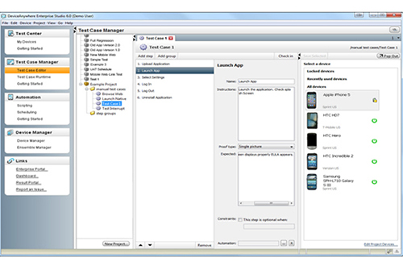
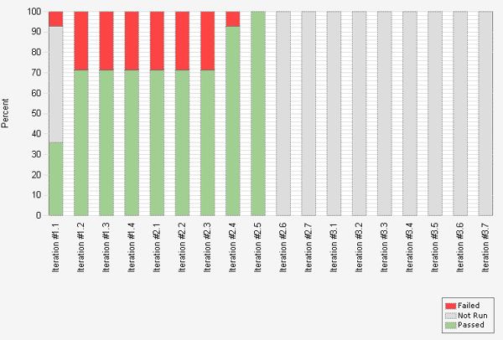
Test Case Examples
Quick Demo
Notes:
http://www.ufjf.br/eduardo_barrere/files/2011/06/SQETestCaseSpecificationTemplate.pdf
Test Manager

Slide 23

The Test Oracle
A mechanism for predicting the expected results
Can be the product specification
Can be another similar product
The result can be inverted and compared to the initial input
The code itself should not be used as a test oracle

Slide 24

Test Implementation and Execution

Slide 25

What This Phase Includes?
Test conditions and logical test cases are transformed into concrete test cases
The environment is set up to support the test execution activity
Tests are executed and logged

Slide 26
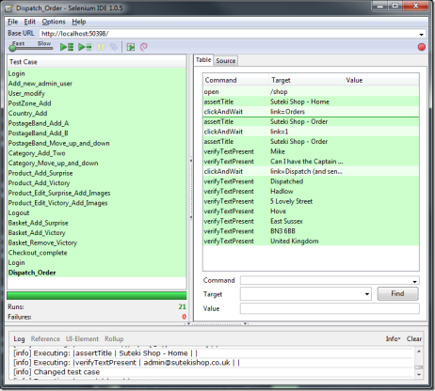
Test Case Execution
How the tests will be executed?
Follows the priority of the test cases set in the test plan
Grouping test cases into test suites
For efficient test execution
For easier overview

Slide 27
Examination of the Main Functions
Starting testing with the main functions is recommended
Failures occurred at this stage make further testing pointless
Correction must be done before continuing
Time pressure may cause running just a subset of all tests
Having tests prioritized is important

Slide 28

Test Protocols
Tests without a protocol are of no value
The test execution must be exactly and completely logged
What tests were made
Who made the tests
Which parts
When
How intensively
With what results
Software version

Slide 29
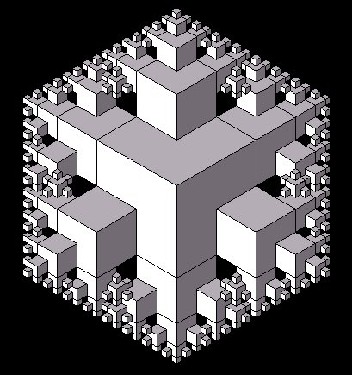
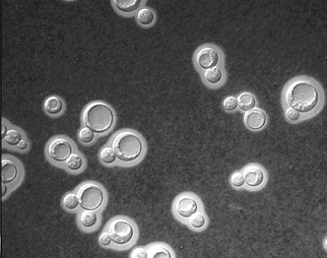
Reproducibility
The tests must be easily repeated
Test environment
Input data
Test logs
Etc.

Slide 30

Failure Found?
Is it really a failure?
Erroneous or inexact test specification
Problematic test infrastructure or test case
Incorrect test execution
If it is a failure:
The failure must be documented
Rough analysis of possible causes
Additional test cases might be required

Slide 31

Correction May Lead to New Faults
After each correction we must check:
Is the fault really corrected
Are there new faults introduced

Slide 32
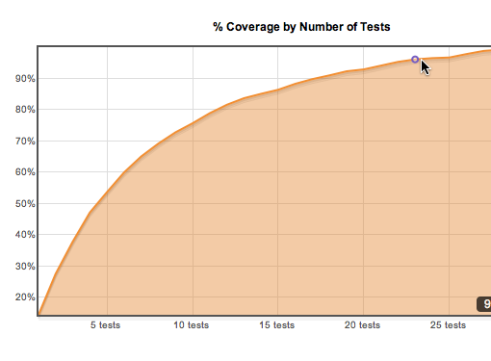
Evaluating Exit Criteria and Reporting

Slide 33

Exit Criteria
What is exit criteria?
The set of generic and specific conditions for permitting a process to be officially completed
Agreed upon with the stakeholders
Used to report against and to plan when to stop testing

Slide 34
Exit Criteria - Example
A simple example of test exit criteria might be:
100% statement coverage
100% requirement coverage
all screens / dialogue boxes / error messages seen
100% of test cases have been run
100% of high severity faults fixed
80% of low & medium severity faults fixed
maximum of 50 known faults remain
maximum of 10 high severity faults predicted
time has run out
testing budget is used up

Slide 35

End of Test?
Were test exit criteria fulfilled?
Test exit criteria might turn to be unrealistic
Then exit criteria should be corrected

Slide 36

Test Summary Report
Summary reports might have different size
Simple message to the project manager
Used in lower level tests
E.g., component tests
Formal reports for the stakeholders
Used in higher-level tests
E.g., integration tests, system tests

Slide 37

Test Closure Activities

Slide 38

Save The Experience
The experience gathered should be analyzed and made available for further projects
Achieved results
Unexpected events
What were their causes?
Open change requests
Why were they not implemented?
User acceptance after deploying

Slide 39



Metrics and Measurement
Notes:
http://www.softwaretestingtimes.com/2011/01/measurement-in-software-testing-test.html
http://www.slideshare.net/pmvenkateshbabu/testing-metrics

Slide 40

Metrics and Measurement Examples
What can be subjected to a metric and tracked through measurement?
Test coverage
Defects
Including total found, total fixed, current backlog, average closure periods, and configuration, subsystem, priority, or severity distribution
Workload and resource usage
Planned and actual costs

Slide 41

Metrics and Measurements
Metrics and measurements should be applied throughout the software development lifecycle
Should be aligned with project goals and objectives
This enables test analysts to track and report test and quality results to management in a consistent and coherent way

Slide 42

Lack of Metrics
A lack of metrics and measurements leads to purely subjective assessments of quality and testing
This results in disputes over the meaning of test results toward the end of the lifecycle
Also results in a lack of clearly perceived and communicated value, effectiveness, and efficiency for testing

Slide 43
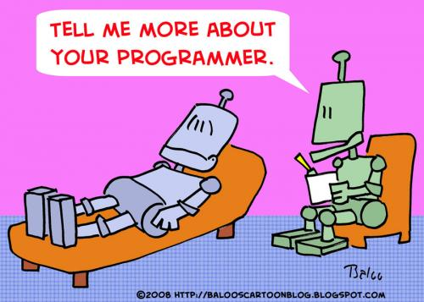
The Psychology Of Testing
Some Psychological Factors

Slide 44

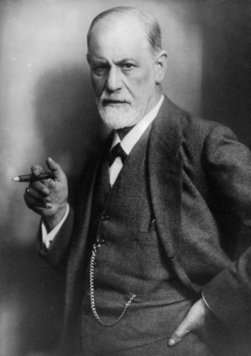
Psychological Factors
Different mindset is required:
For testing and reviewing
For developing software
Separation of testing from development
Helps focusing effort
Avoids subjectivity

Slide 45

Levels of Independence
Tests can be designed by:
The person who wrote the software
Another person (e.g. from another team)
Person(s) from a different organizational group (independent test specialist)
Person from a different organization or company

Slide 46
Reporting Failures
Pointing out ones failures might be perceived as criticism
Communicate bugs in a constructive way
Start with collaboration rather than battles
Focus on the facts, not the person
Try to understand the way the other person feels
Be sure the other person understood what you have said

Slide 47
Fundamental Test Process

Slide 48
Exercises
Which activity in the fundamental test process creates test suites for efficiency of testing?
Implementation and execution
Planning and control
Analysis and design
Test closure

Slide 49
Exercises (2)
What is the purpose of exit criteria?
To define when a test level is complete
To determine when a test has completed
To identify when a software system should be retired
To determine whether a test has passed

Slide 50
Exercises (3)
Which is not a test Oracle
The existing system (for a benchmark)
The code
Individual’s knowledge
User manual

Slide 51
Exercises (4)
Reviewing the test basis is a part of which phase
Test Analysis and Design
Test Implementation and execution
Test Closure Activities
Evaluating exit criteria and reporting

Slide 52
Exercises (5)
A test plan defines
What is selected for testing
Objectives and results
Expected results
Targets and misses

Slide 53
Exercises (6)
Which of the following is most important to promote and maintain good relationships between testers and developers?
Understanding what managers value about testing
Explaining test results in a neutral fashion
Identifying potential customer workarounds for bugs
Promoting better quality software whenever possible

Slide 54
Exercises (7)
Which of the following is not a part of the Test Implementation and Execution Phase
Creating test suites from the test cases
Executing test cases either manually or by using test execution tools
Comparing actual results
Designing the Tests

Slide 55
Exercises (8)
Search the Internet and any books you have available and find additional information about the following topics:
Designing test cases
Test protocols – methods for test documentation
Test metrics

Slide 56
Exercises (9)
Search the Internet for some examples of test plans
Note the main structure of test plans
Note the differences between the test plans you find

Slide 57
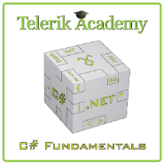



Free Trainings @ Telerik Academy
C# Programming @ Telerik Academy
csharpfundamentals.telerik.com
Telerik Software Academy
academy.telerik.com
Telerik Academy @ Facebook
facebook.com/TelerikAcademy
Telerik Software Academy Forums
forums.academy.telerik.com

